Slide 1
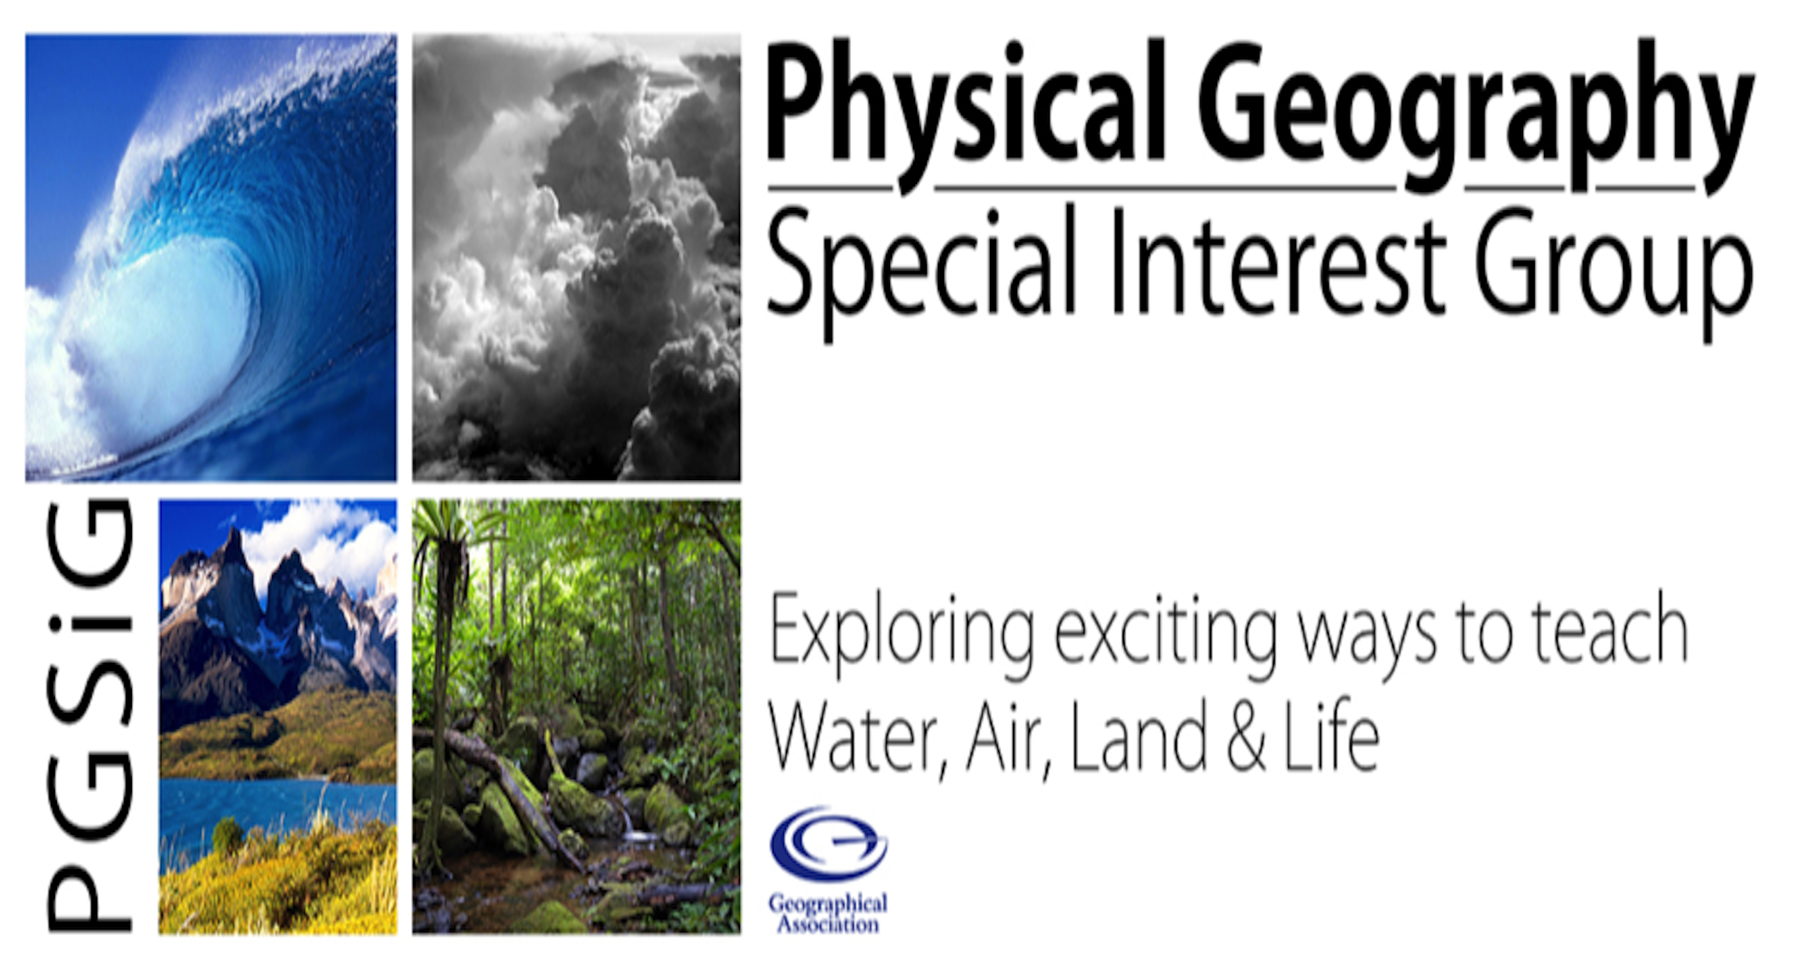
Making Physical Geography
accessible to all
Adam Corbridge
@GAPGSIG
@MrCorbridgeGeog

Slide 2
What physical Geography concepts and terms do not register with students?
% of 1st year undergraduate students unfamiliar with physical geography term.
Source: Birnie (1999) Figure 2
Source: Birnie (1999) Journal of Geography in Higher Education
Physical Geography at the Transition to Higher Education: the effect of prior learning
Notes:
The official research out there is quite limited, but this study gives a useful insight, bearing in mind this is a survey of Undergraduate geographers.

Slide 3
What physical Geography topics do students find easy and difficult?
Source: Birnie (1999) Figure 3.

Slide 4
Making Physical Geography accessible to all
What makes Physical Geography ‘tricky’?
It’s complex
Reality doesn’t fit in with the way we conceive
There’s so much ‘stuff’ about it we don’t quite know what’s going on
Notes:
With PG there are often interactions between various natural processes. They can be very complex and often occur simultaneously, making it difficult to understand the individual processes, or to work out exactly what is happening.
We also have so many models to represent complex natural processes, but do these actually help? Do we take all models as ‘gospel’ and accept that this is how all landforms are created? We often forget (and might even be tempted to pass this onto those we are teaching) that models are just a model and should be critiqued.

Slide 5
Making Physical Geography accessible to all
What makes Physical Geography ‘tricky’?
“Physical geography...oh it’s easy enough to learn the diagrams and I quite like drawing them, and they are easy to do in an exam, but it doesn’t always make sense. I mean … like … low pressure for instance … you know, high pressure, low pressure … how can you have low pressure on the ground when the air pressure gets less as you go up in the atmosphere? The pressure should always be high. And where it is hottest like the Sahara desert where the high pressure is … you know the convection thingy (i.e. the atmospheric circulation model) … well this is where the air should be rising not sinking.”
Rebecca, aged 15
Notes:
This is a helpful quote by Rebecca (and also features in one of our blog pieces on misconceptions in physical geography) and shows just how students can misunderstand things we’re teaching them.

Slide 6


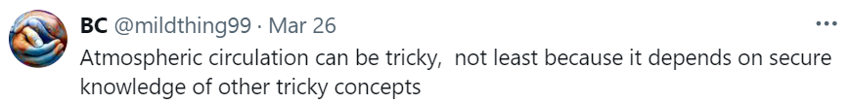
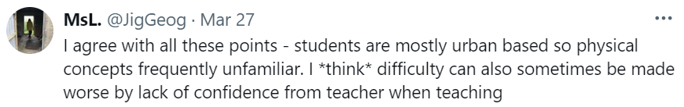
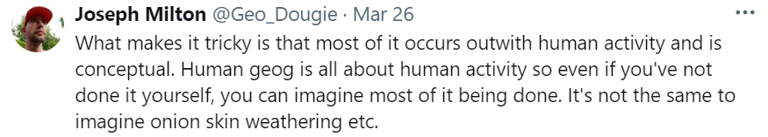

Making Physical Geography accessible to all
What makes Physical Geography ‘tricky’?
Notes:
I thought I’d do a bit of my own research, so I went on X (or Twitter) and asked the question last week. Here are a few of the responses…

Slide 7
Making Physical Geography accessible to all
What do students say?
Volcanoes and Earthquakes
Water Cycle
Tropical Storms
Glacial processes
Wave processes
Coastal landforms
Weathering
Geological Timescales
‘Easier’
topics
‘Harder’
topics
Notes:
When asking students what it is, there are a few common themes. These are all topic areas that came up consistently as either ‘more tricky’ or ’less tricky’

Slide 8
Making Physical Geography accessible to all
What makes Physical Geography ‘tricky’?
Complex interactions
Different spatial and temporal scales
Physical Geography is a dynamic beast!
Minute Earth video: https://youtu.be/J6d0UqY6IsA?si=iGlasbIKZgHK3F7S
Notes:
So, as we’ve seen there is a great complexity to some areas of Physical Geography.
We also have the issue of scale to deal with as well – phenomena changing on different spatial and temporal scales which makes it hard to imagine what has happened previously, and maybe even what might happen in the future.
Physical Geography is brilliant, but it is also such a dynamic field. Natural systems inherently evolve over time. Predicting the future behaviour of these systems requires a deep understanding of what has gone before and the present conditions, which can be rather ‘tricky!’

Slide 9
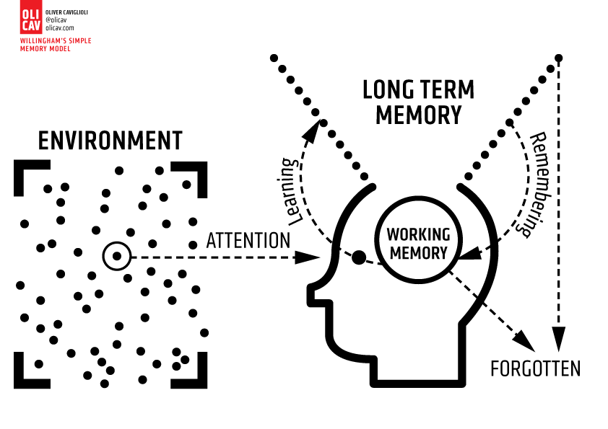
How can we make Physical Geography more accessible?
“Memory is the residue of thought”
Daniel Willingham
Source: https://www.olicav.com/posters/kfjy9acxwmmqp6sro7rqq1hwpyxn77
Notes:
If we’re going to make PG more accessible to everyone, we have to pay attention to how students’ minds and memories work.
I like the classic quote by Daniel Willingham: “Memory is the residue of thought”.
We need students to think hard about what we’re teaching them if they are to engage with it properly and learn/remember it. We also need to take that on board ourselves and ensure we fully understand what we’re teaching to our students.

Slide 10
How can we make Physical Geography more accessible?
Make sure we are confident and familiar with the concepts and processes ourselves (!)
Break things down into manageable steps
Allow time and don’t rush through it… (I know this is difficult given curriculum pressures)
Teach/examine the context of the processes/landforms you’re teaching
Use visual aids and hands-on activities
Use models (carefully) to help students visualise the processes
in action – these need to be critiqued

Slide 11
How can we make Physical Geography more accessible?
Carousel: three different activities
Split into 3 groups
10-15 minutes per station to trial and discuss the activity
Move around and try each activity during the session
(notes and all resources for each activity are available to all via our blog – QR code will be shared at the end)

Slide 12
Source: https://www.earthlearningidea.com/PDF/347_What_drives_plates1.pdf

Slide 13

Making Physical Geography accessible to all
What have you found?
Use the QR code
to reflect on what we have done during this session.

Slide 14

Making Physical Geography accessible to all
Any Questions?
All resources from today’s workshop
are available to access via our blog.
www.teachingphysicalgeog.wordpress.com teachphysgeogblog@gmail.com
@GAPGSIG

